Slide 1


Slide 2
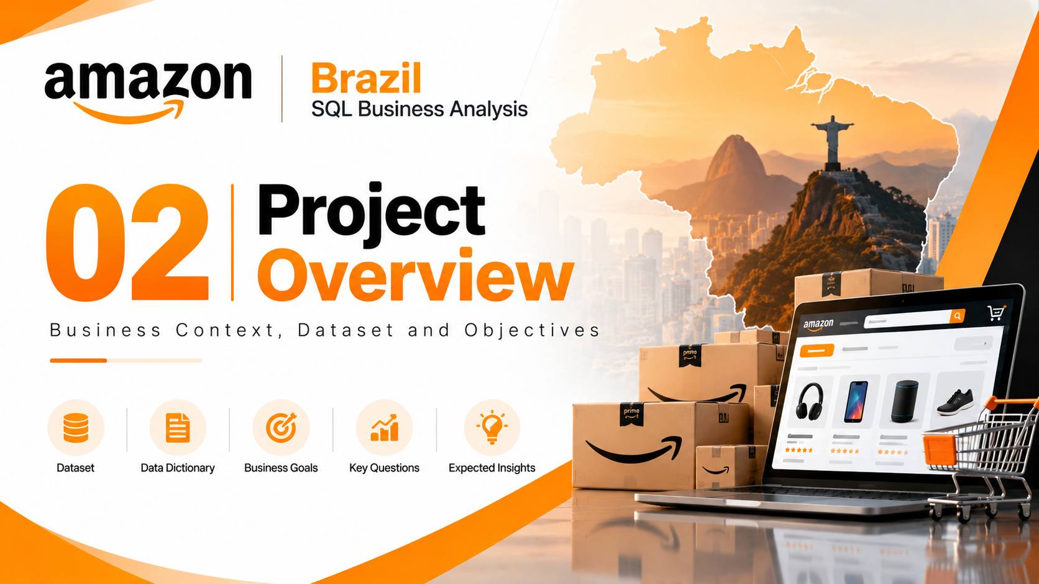

Slide 3
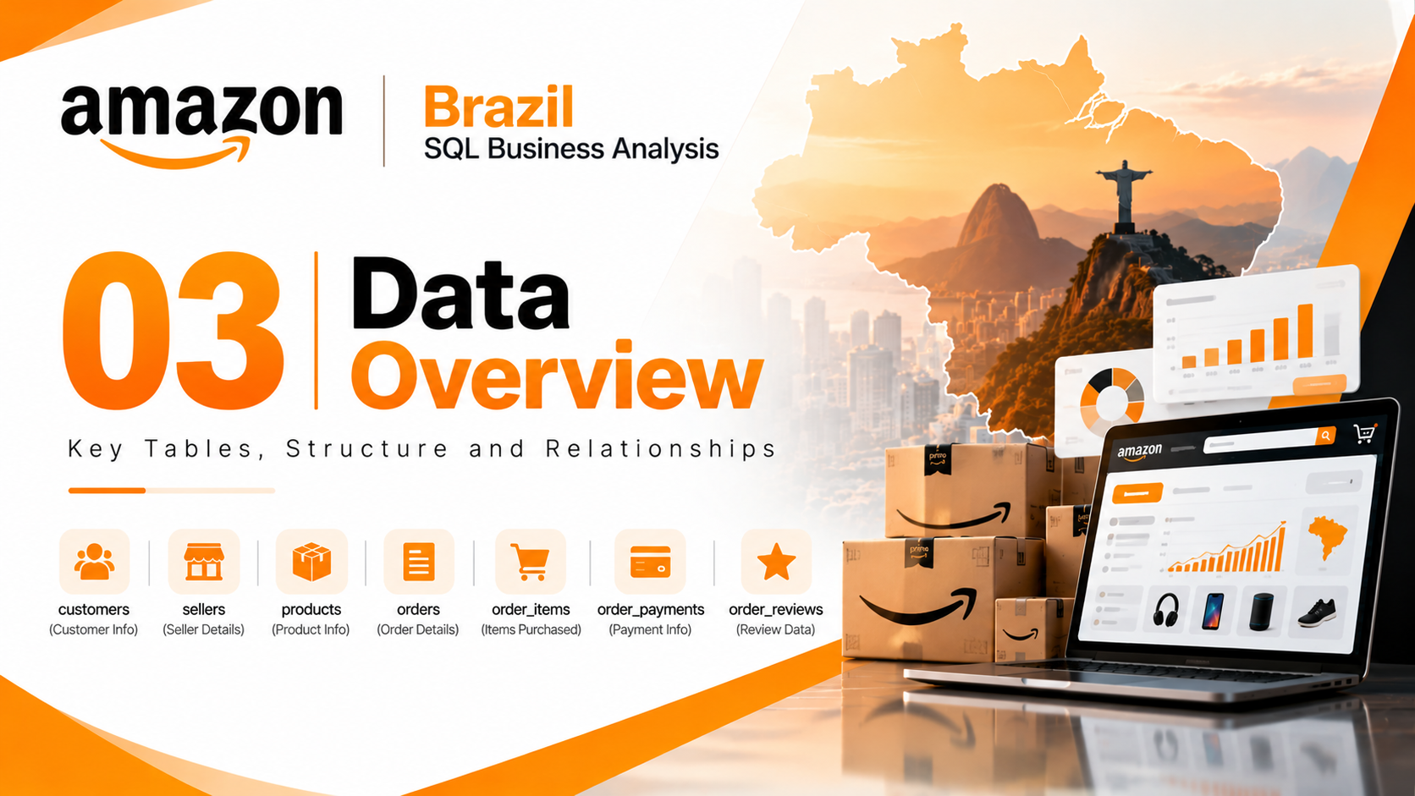

Slide 4
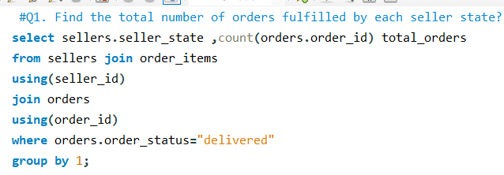
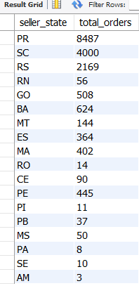
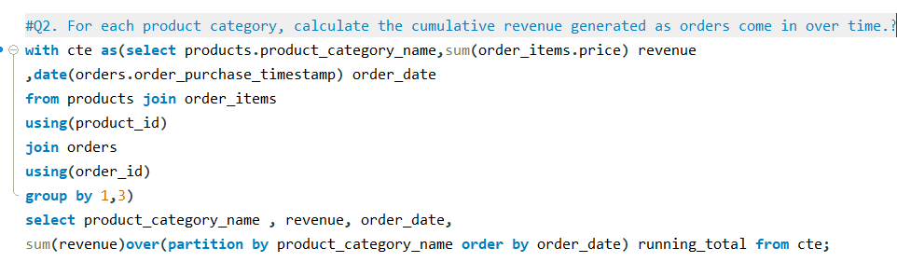
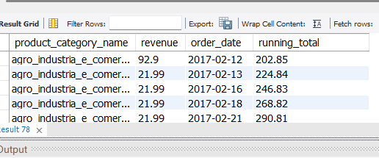
AMAZON BRAZIL | SQL ANALYSIS | QUESTIONS 1–2
Q1 | Total orders fulfilled by each seller state
ORIGINAL QUERY SCREENSHOT
ORIGINAL RESULT SCREENSHOT
Q2 | Cumulative revenue by product category over time
ORIGINAL QUERY SCREENSHOT
ORIGINAL RESULT SCREENSHOT

Slide 5
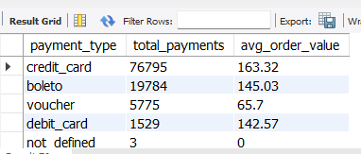
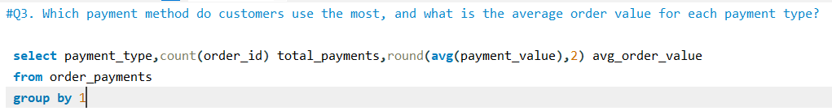
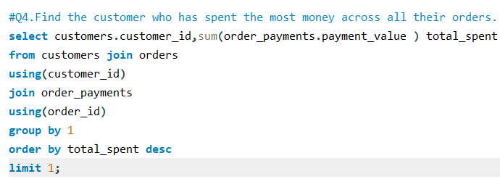
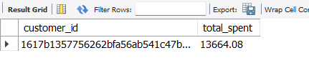
AMAZON BRAZIL | SQL ANALYSIS | QUESTIONS 3–4
Q3 | Most-used payment method and average order value
ORIGINAL QUERY SCREENSHOT
ORIGINAL RESULT SCREENSHOT
Q4 | Customer who spent the most across all orders
ORIGINAL QUERY SCREENSHOT
ORIGINAL RESULT SCREENSHOT

Slide 6
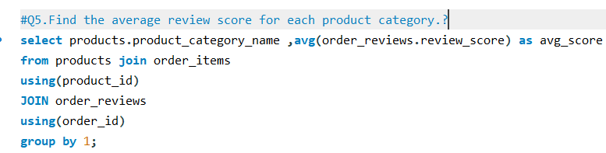
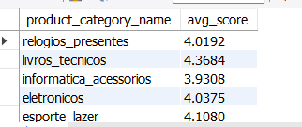
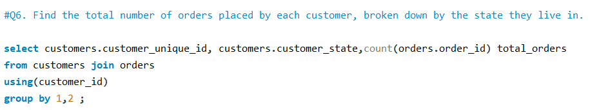
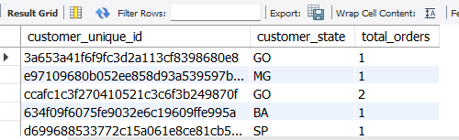
AMAZON BRAZIL | SQL ANALYSIS | QUESTIONS 5–6
Q5 | Average review score for each product category
ORIGINAL QUERY SCREENSHOT
ORIGINAL RESULT SCREENSHOT
Q6 | Orders placed by each customer, by customer state
ORIGINAL QUERY SCREENSHOT
ORIGINAL RESULT SCREENSHOT

Slide 7
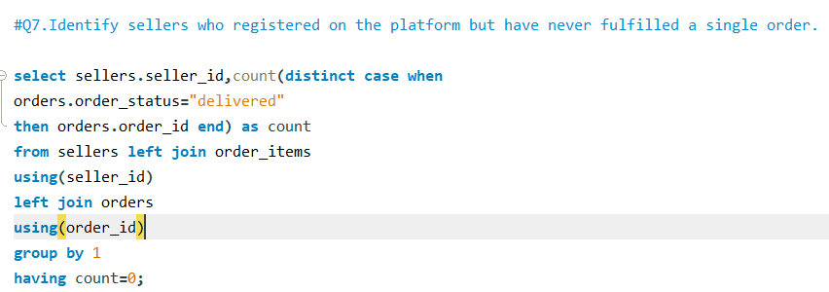
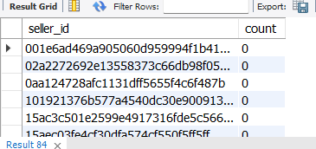
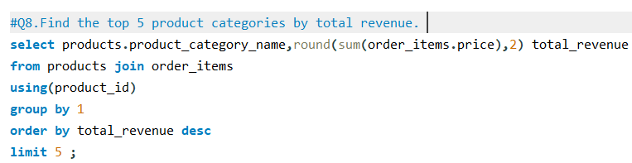
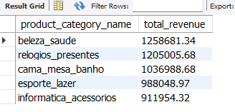
AMAZON BRAZIL | SQL ANALYSIS | QUESTIONS 7–8
Q7 | Sellers who registered but never fulfilled an order
ORIGINAL QUERY SCREENSHOT
ORIGINAL RESULT SCREENSHOT
Q8 | Top 5 product categories by total revenue
ORIGINAL QUERY SCREENSHOT
ORIGINAL RESULT SCREENSHOT

Slide 8
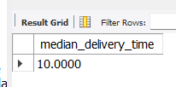
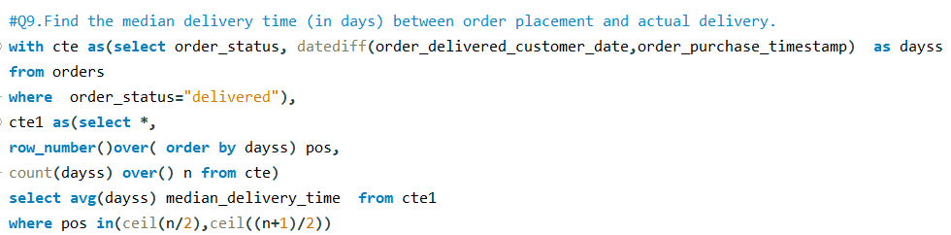
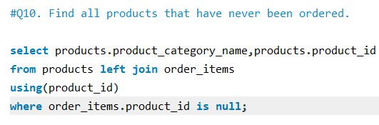
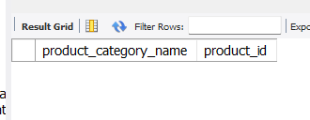
AMAZON BRAZIL | SQL ANALYSIS | QUESTIONS 9–10
Q9 | Average delivery time for orders by seller state
ORIGINAL QUERY SCREENSHOT
ORIGINAL RESULT SCREENSHOT
Q10 | Customers who have never ordered a product
ORIGINAL QUERY SCREENSHOT
ORIGINAL RESULT SCREENSHOT

Slide 9
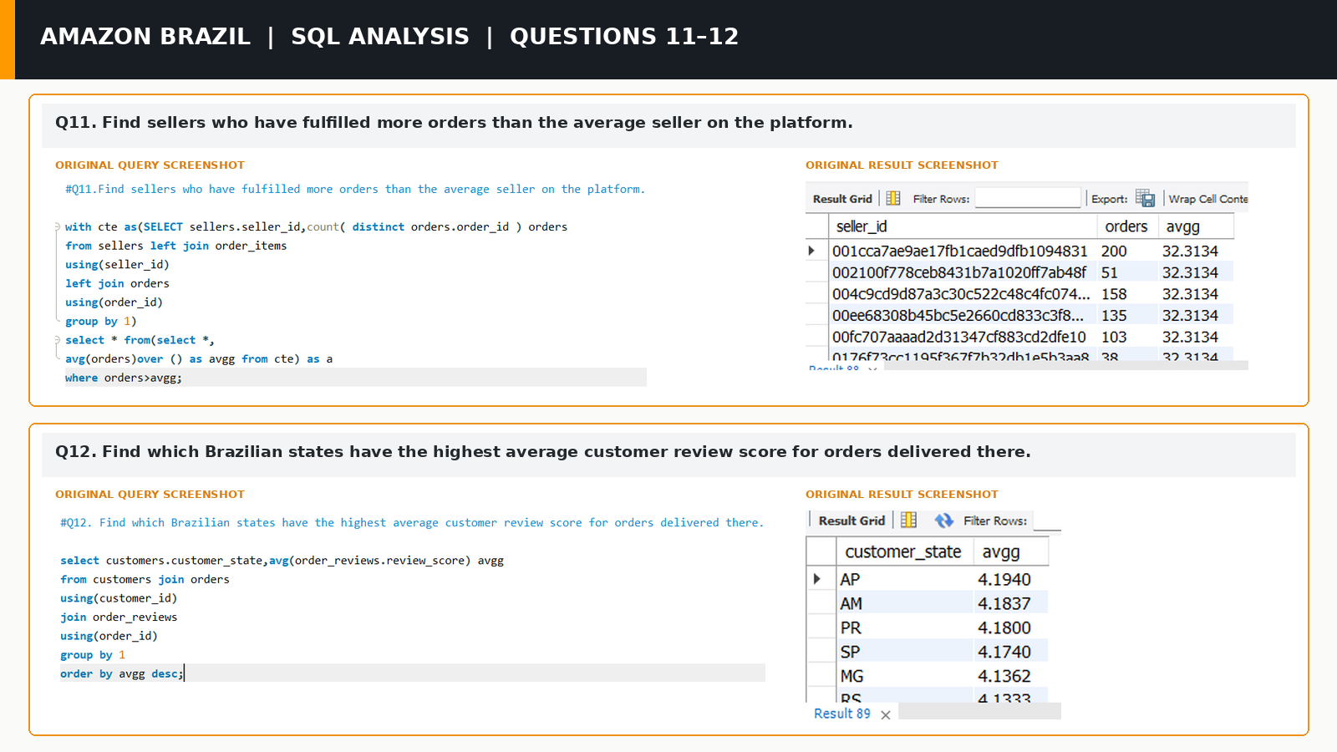

Slide 10
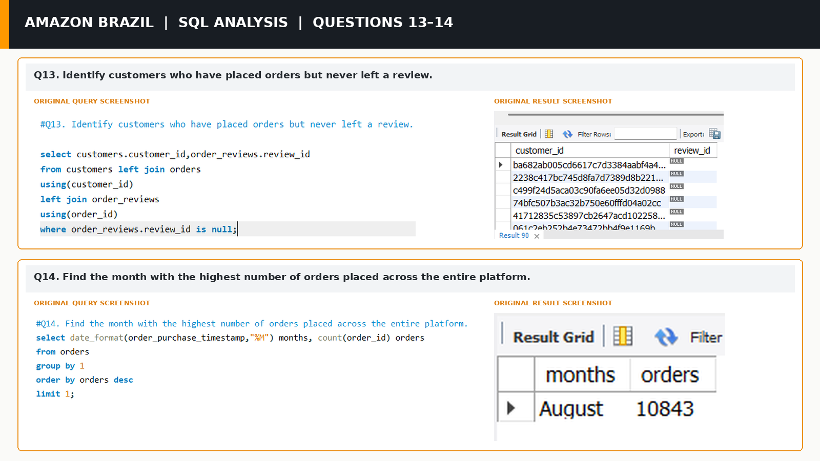

Slide 11


